Slide 1

COVID-19 Infection Rates and Weather Variables in Massachusetts, Connecticut, Vermont, and Maine
Abigail Morgan
Springboard Data Science Capstone
Mentor: Raghu Patthar

Slide 2

Epidemiological effects of weather variables
Transmission dynamics
Host susceptibility
Virus survival

Slide 3

Behavioral effects of weather variables
Social distancing
Mobility levels
Frequency and location of social gatherings

Slide 4
Guiding questions:
What correlation, if any, can be demonstrated between COVID-19 infection rates and weather variables (specifically temperature and precipitation) in Massachusetts, Connecticut, Maine, and Vermont?
What are the capabilities and limitations of a model that uses these weather variables to predict COVID-19 infection rates?
What other interpretations or explanations may exist to explain the results of this model?

Slide 5
Data Sources
NOAA’s National Centers for Environmental Information Database
TAVG: Daily Average Temperature
TMIN: Daily Minimum Temperature
TMAX: Daily Maximum Temperature
PRCP: Daily Total Precipitation
COVID-19 Data Repository by the Center for Systems Science and Engineering (CSSE) at Johns Hopkins University
Daily confirmed cases
03/01/2020 – 09/12/2021

Slide 6
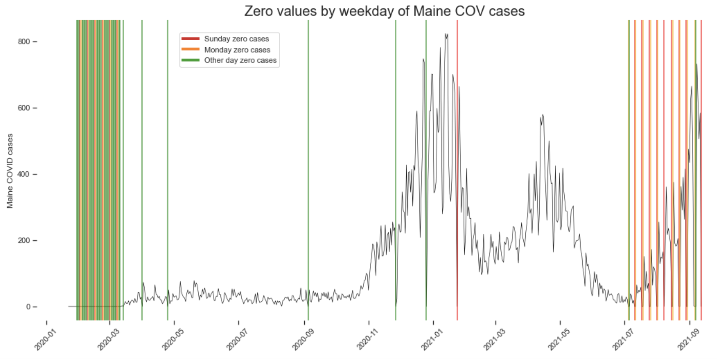
Case Reporting Schedules: Maine

Slide 7
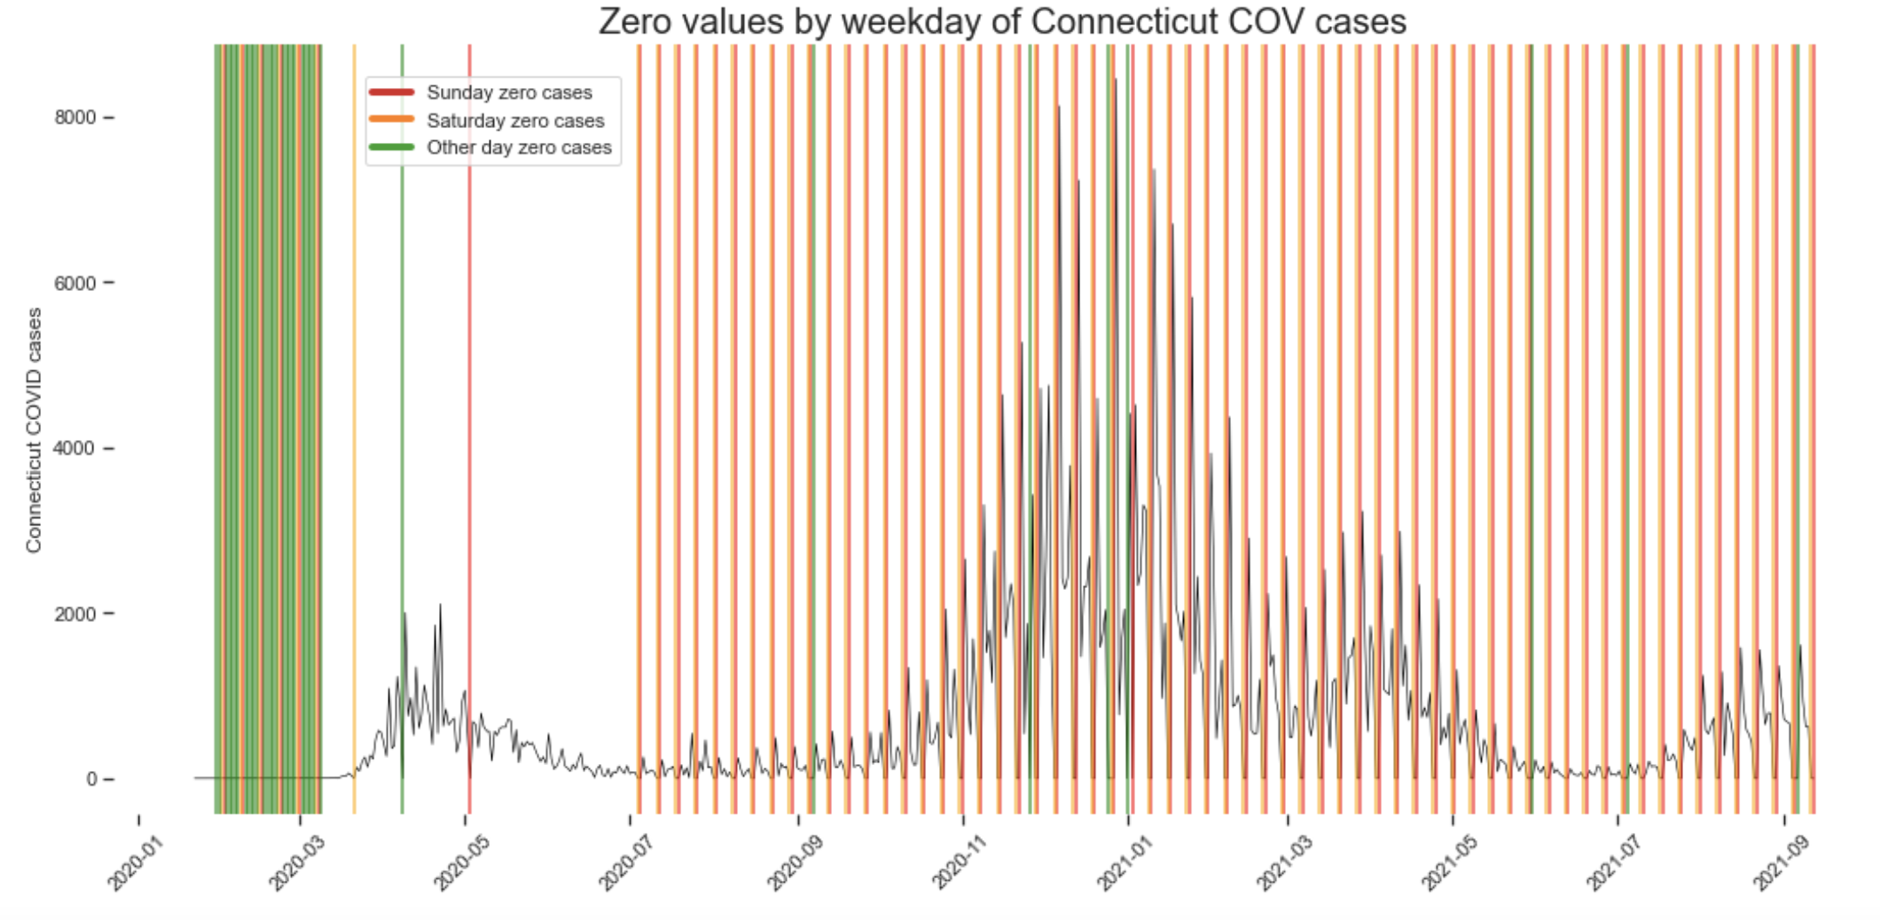
Case Reporting Schedules: Connecticut

Slide 8
Case Reporting Schedules:
Maine: Tuesday- Saturday from 2020-07-01 onwards (and daily before this date)
Massachusetts: Monday- Friday from 2021-07-01 (and daily before this date)
Vermont: Daily 7 days a week except for 2021-06-01 until 2021-08-23 when it temporarily shifted to a Monday- Friday reporting schedule
Connecticut: Monday- Friday from 2020-07-01 onwards (and daily for only a very short period before this date)

Slide 9
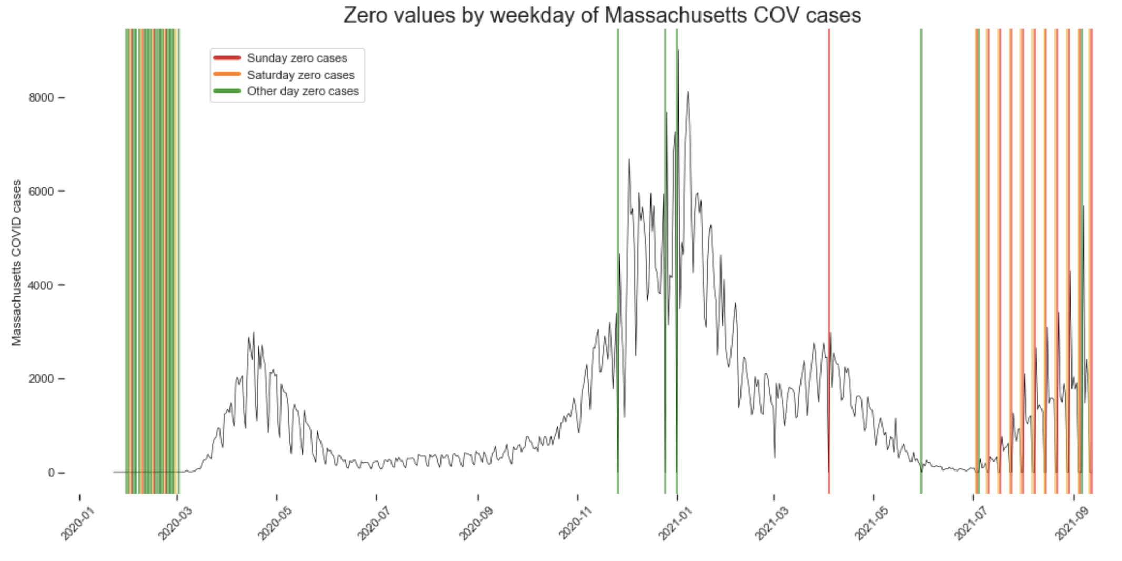
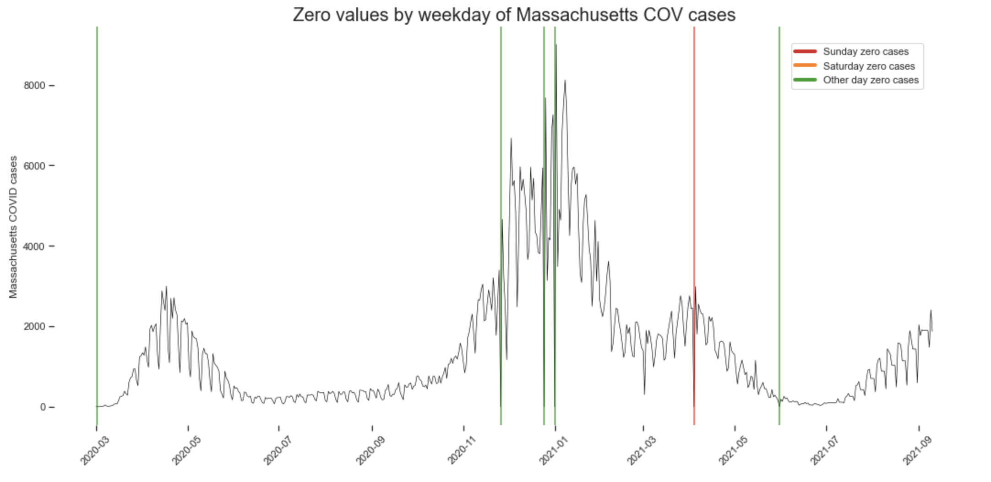
MA Missing values: Before and After

Slide 10
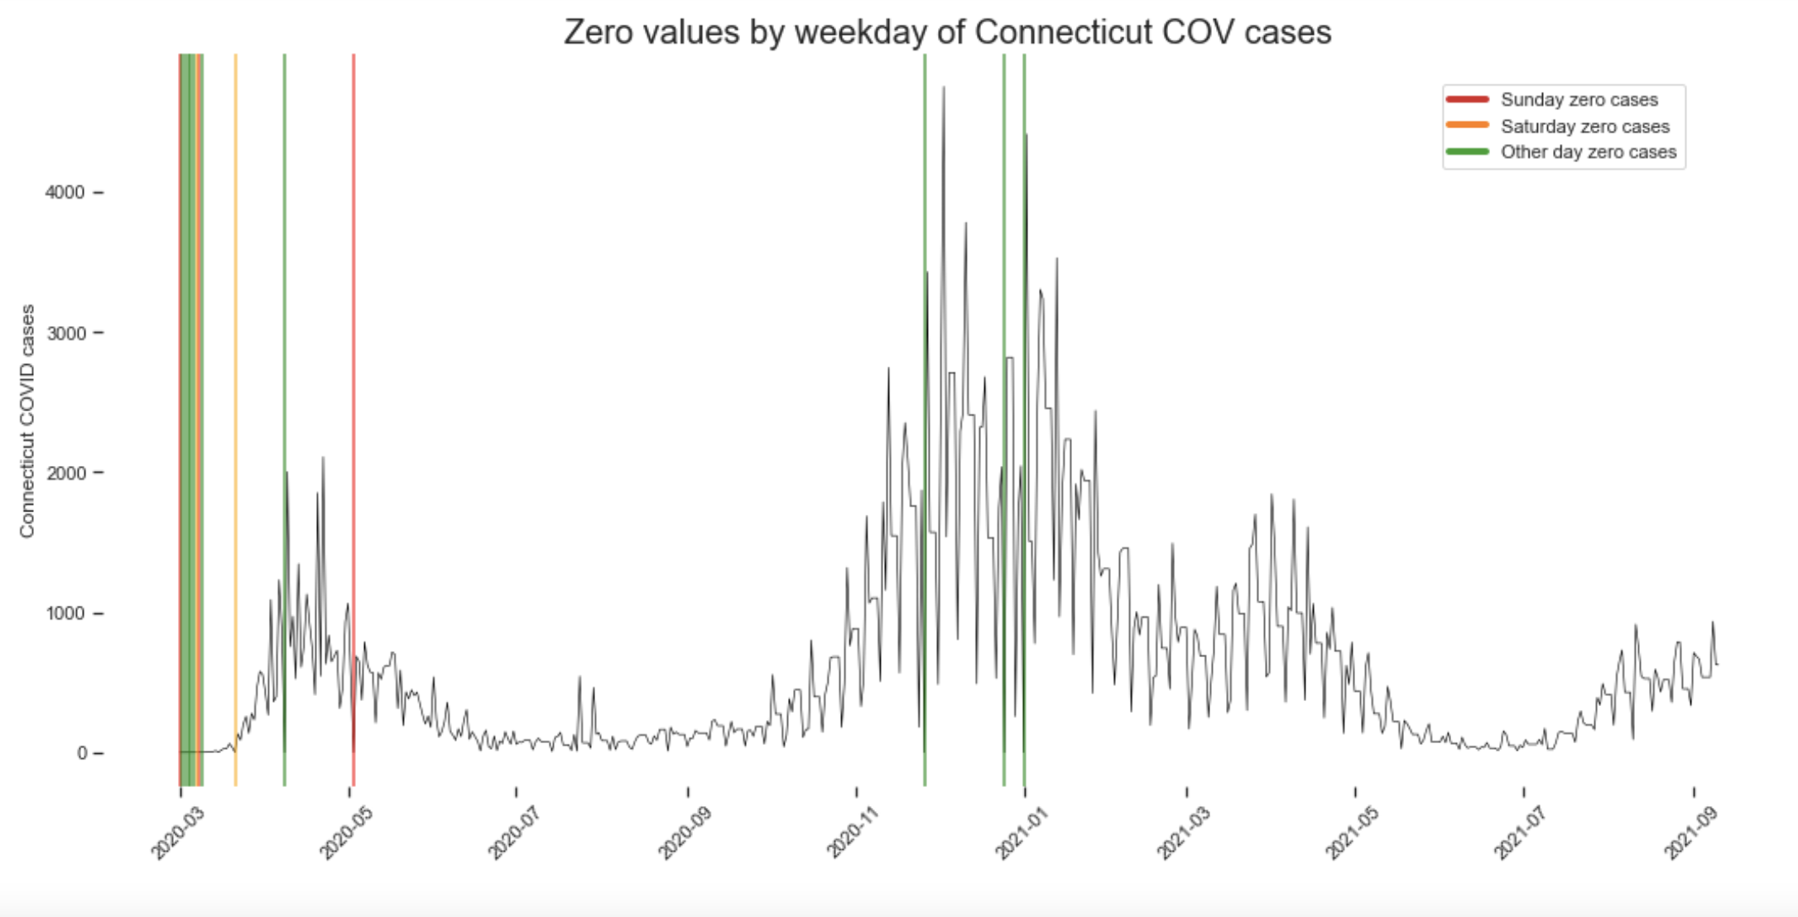
CT Missing Values: Before and After

Slide 11
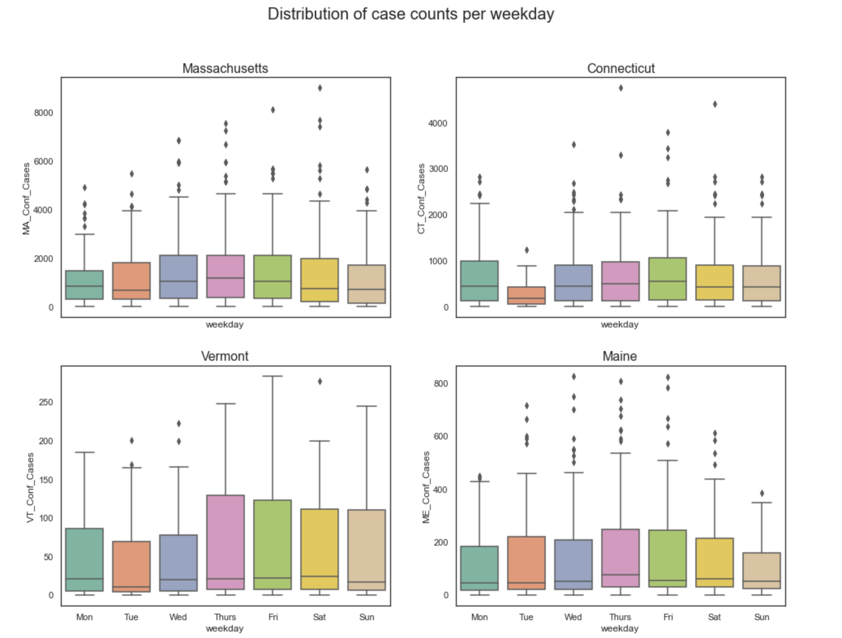
Distribution of case counts per weekday

Slide 12
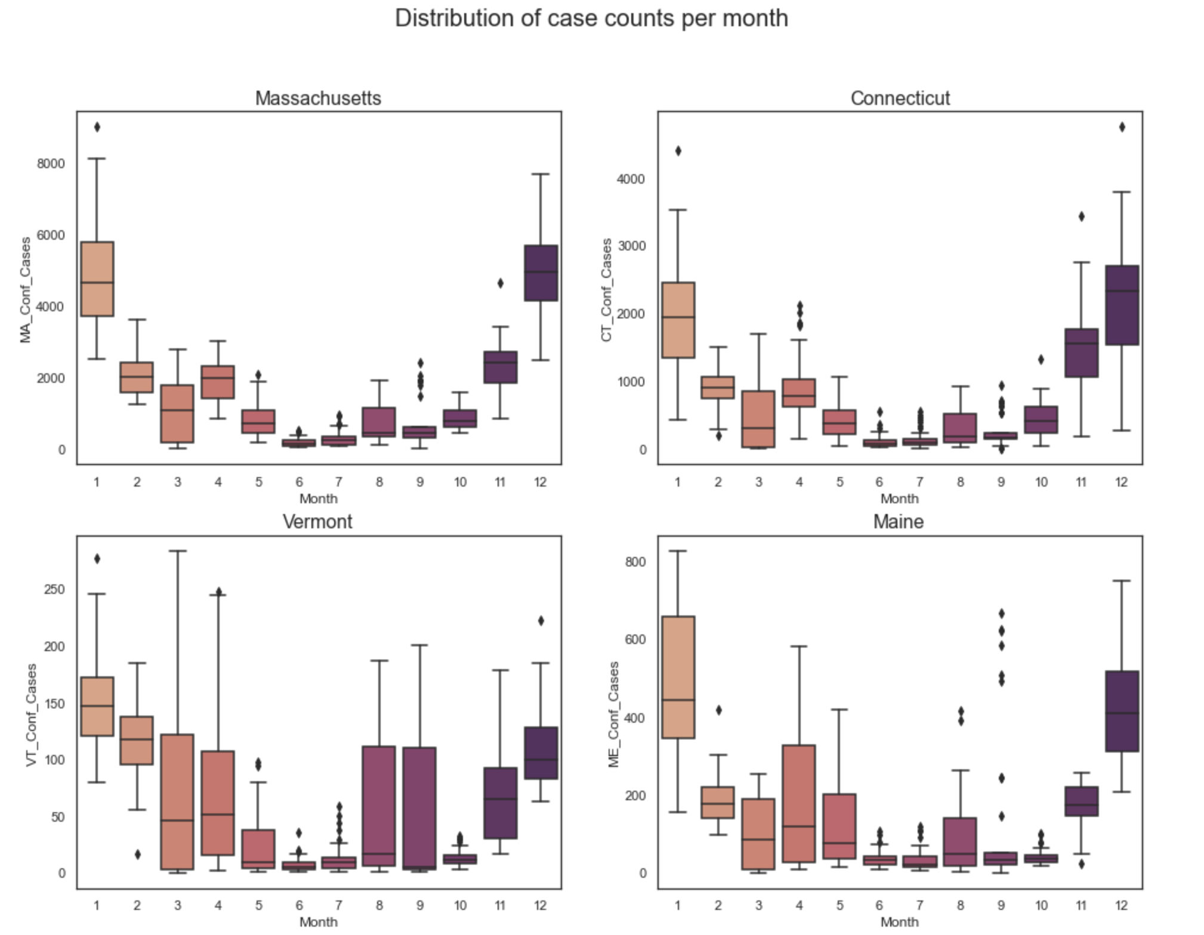
Distribution of case counts per month

Slide 13
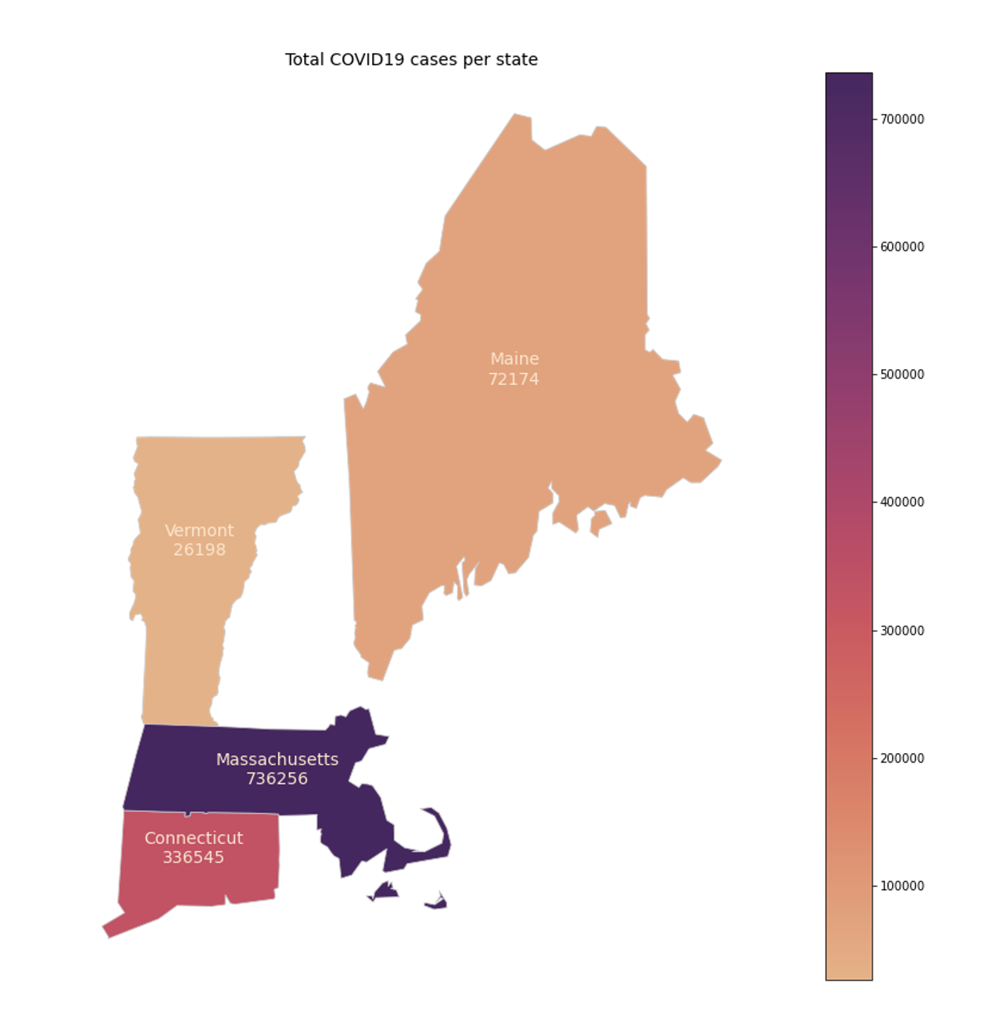
Distribution of case counts per state

Slide 14
Visualizing patterns over time

Slide 15
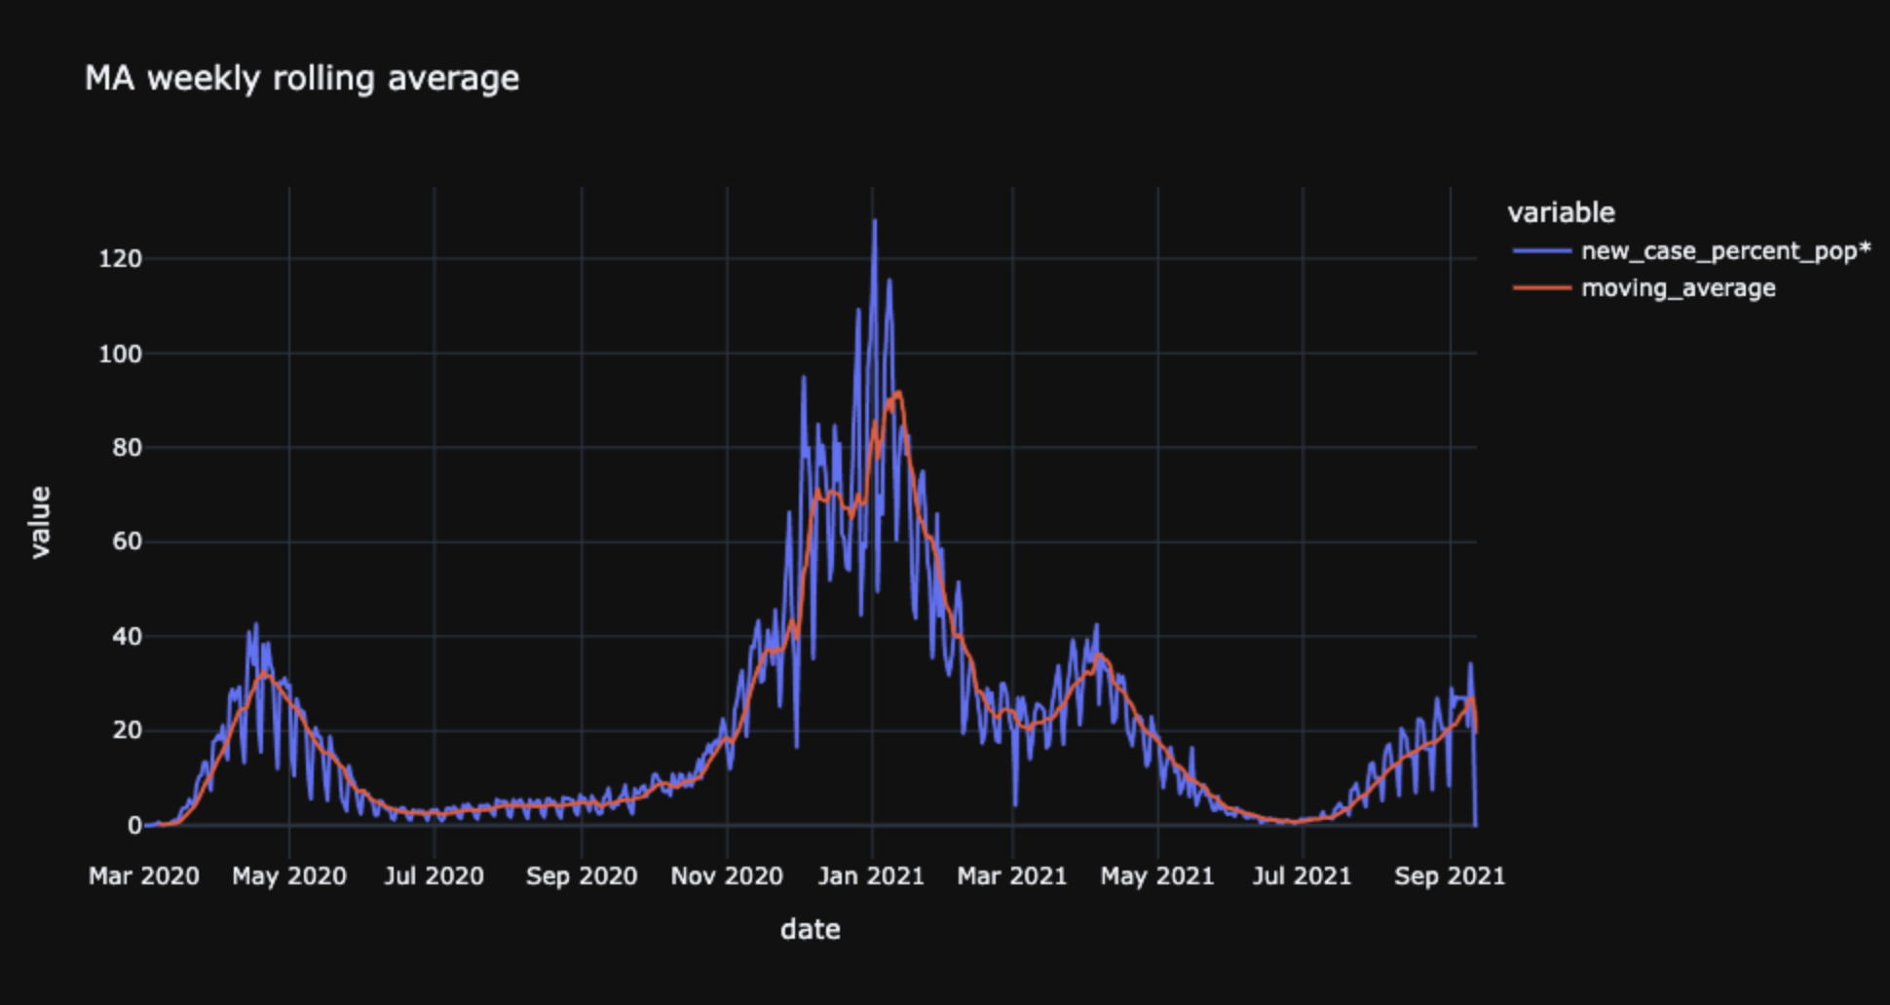

Slide 16
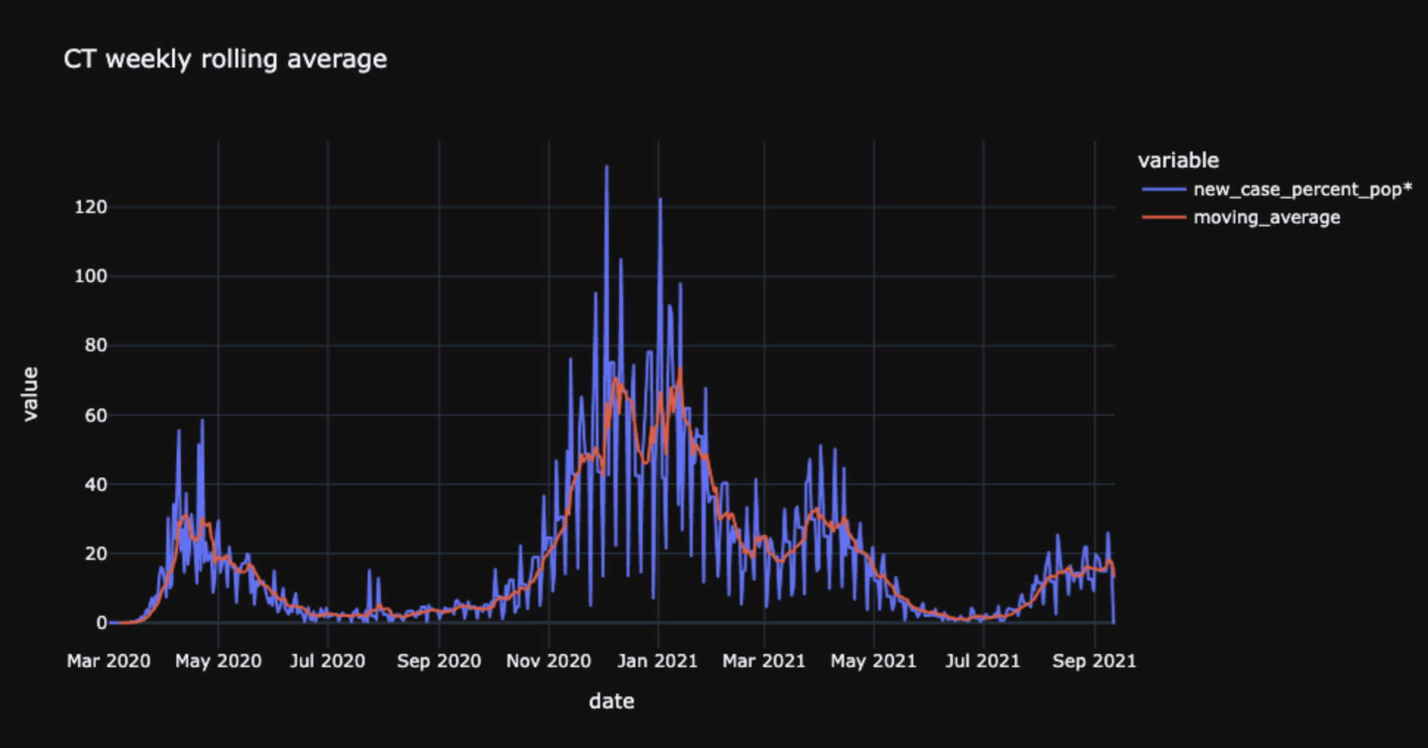

Slide 17
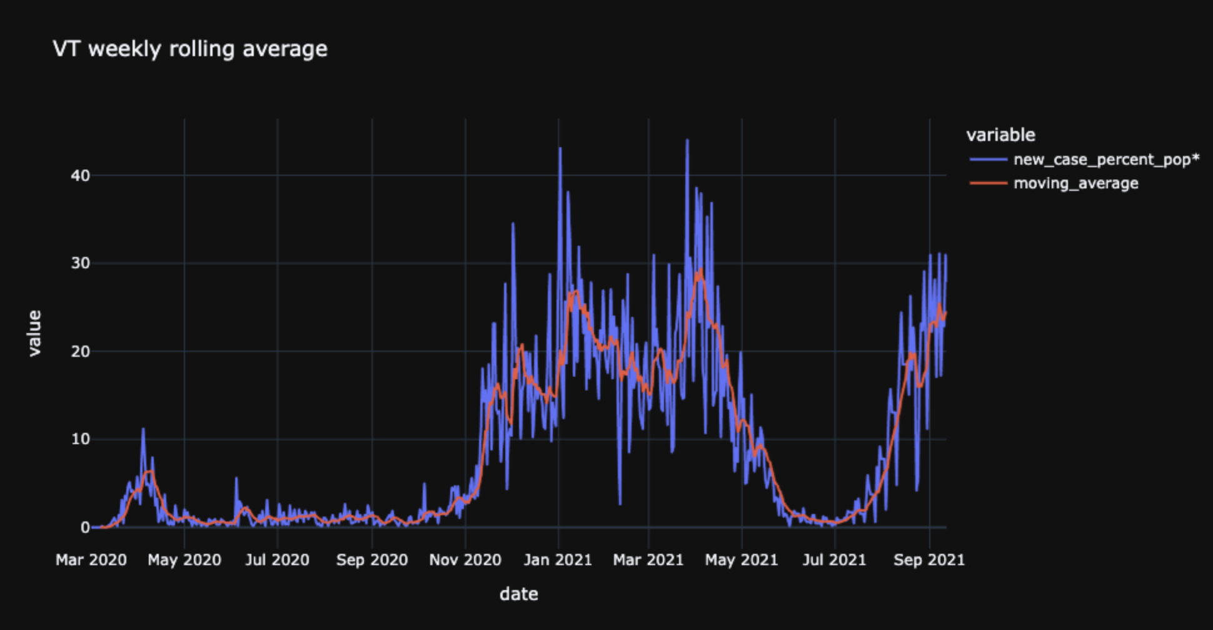

Slide 18
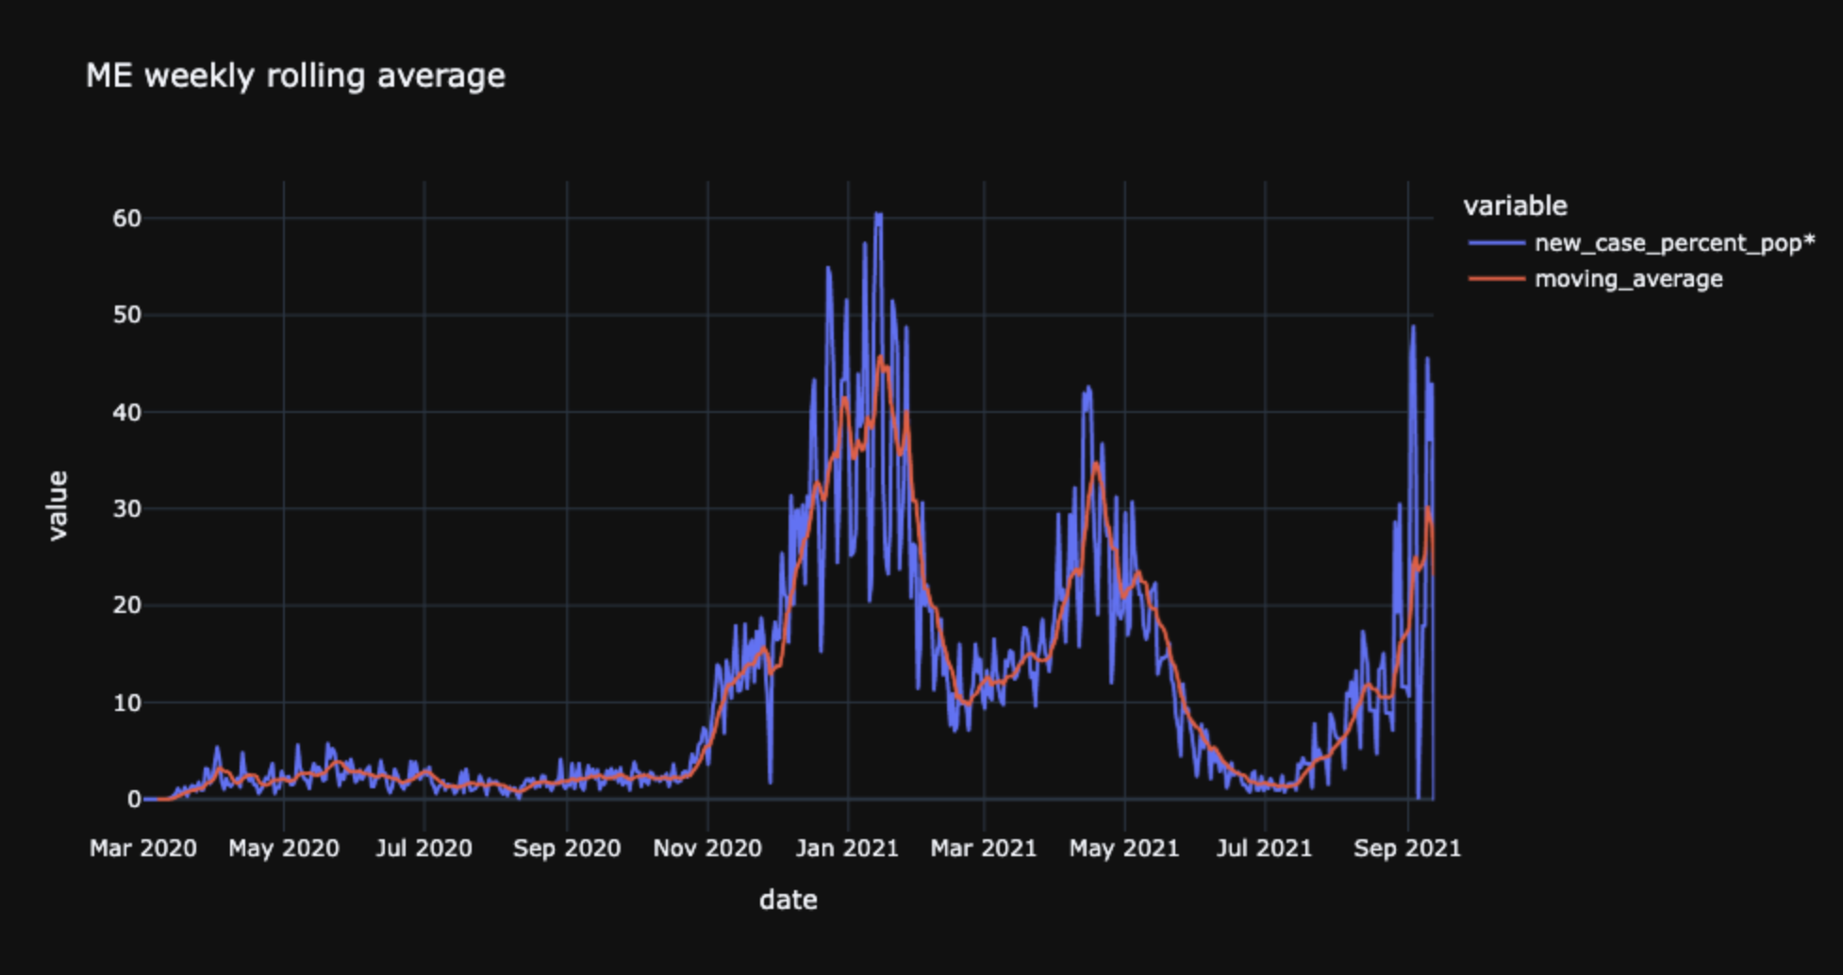

Slide 19
Visualizing relationships between features

Slide 20
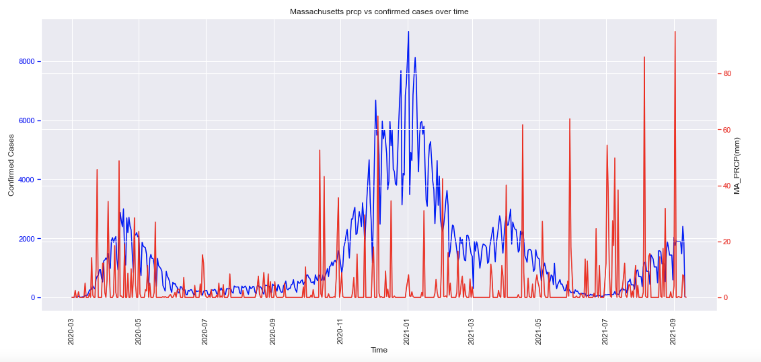
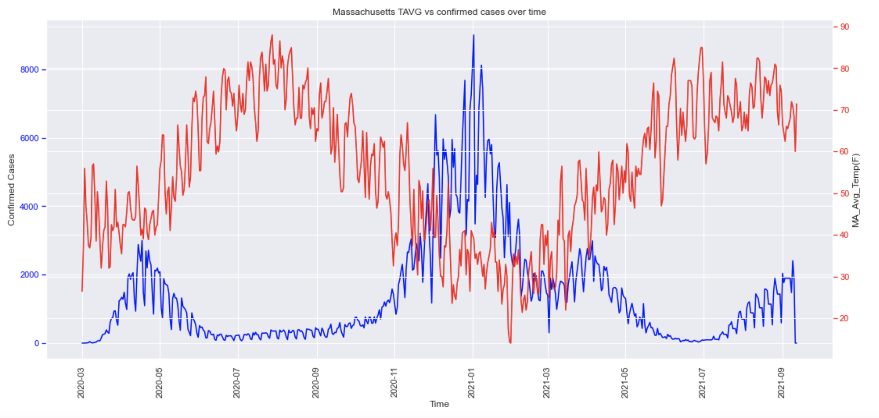
Massachusetts

Slide 21
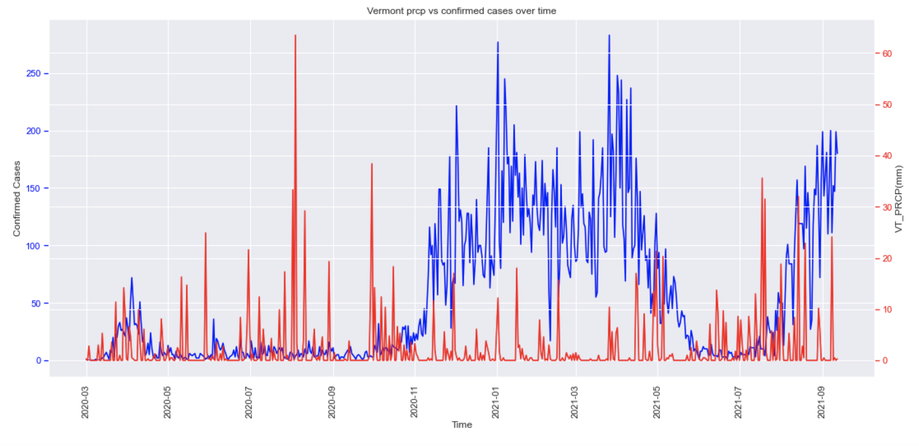
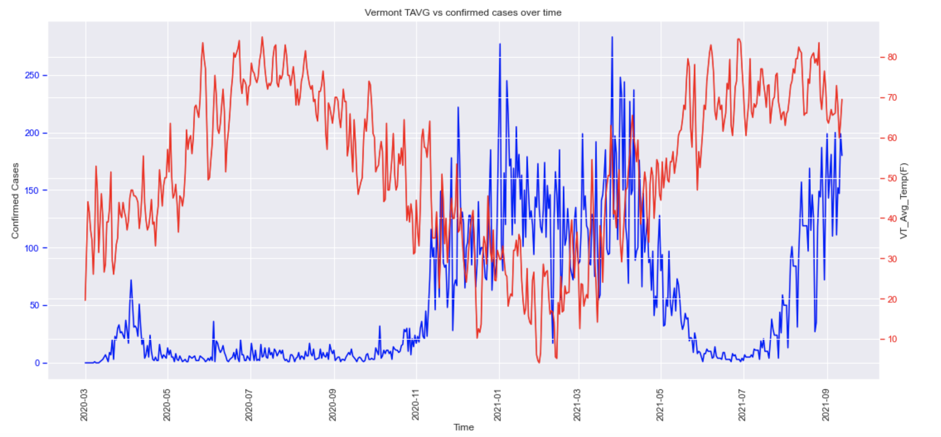
Vermont

Slide 22
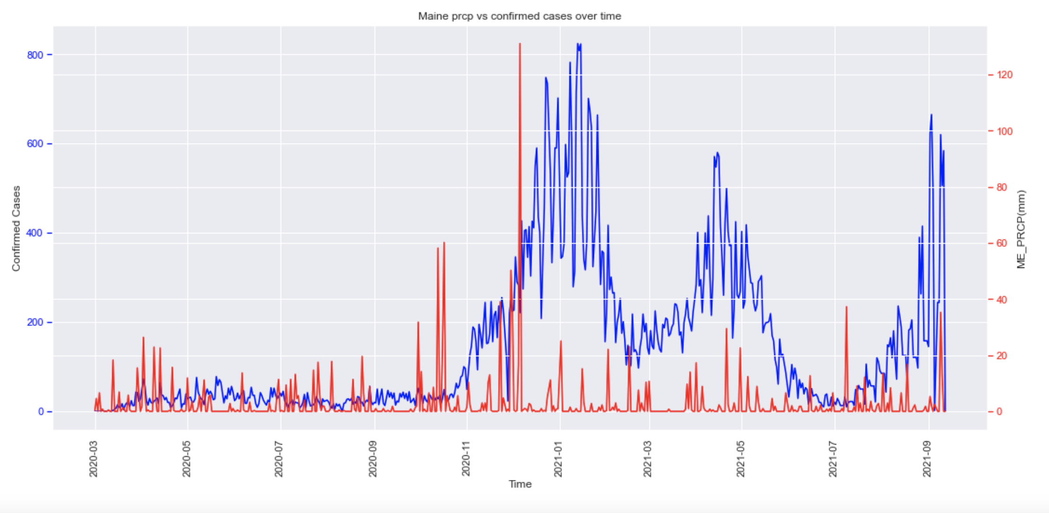
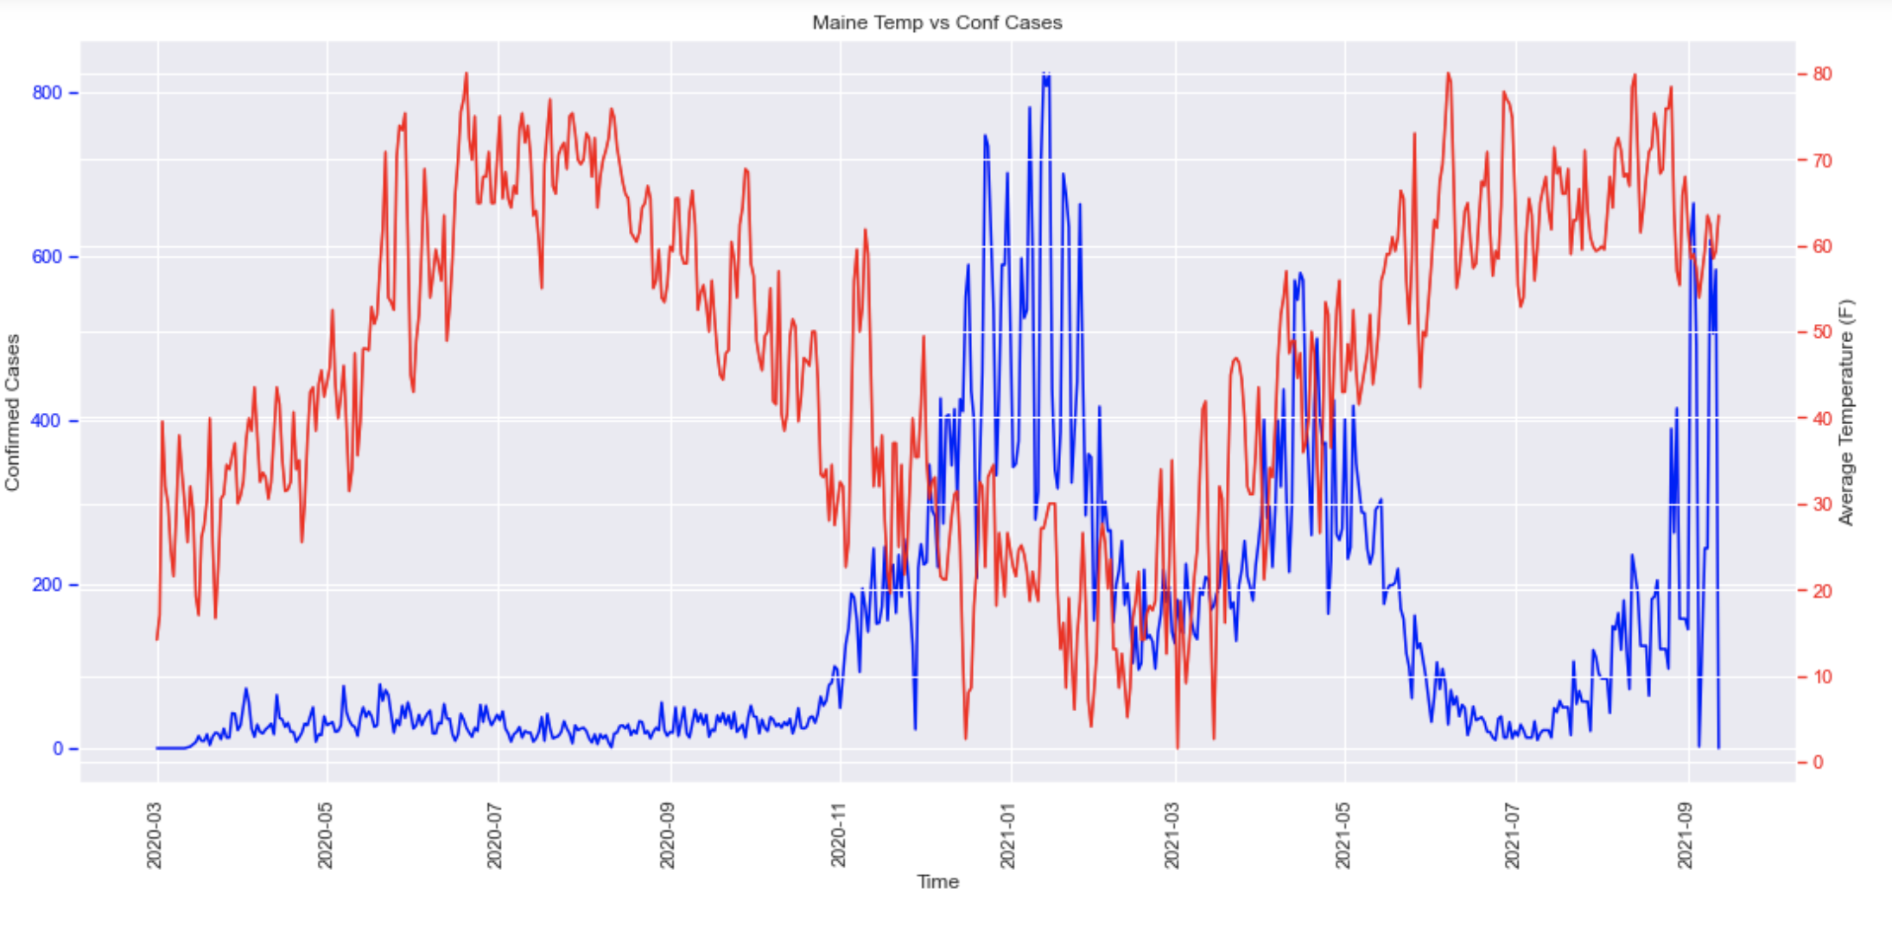
Maine

Slide 23
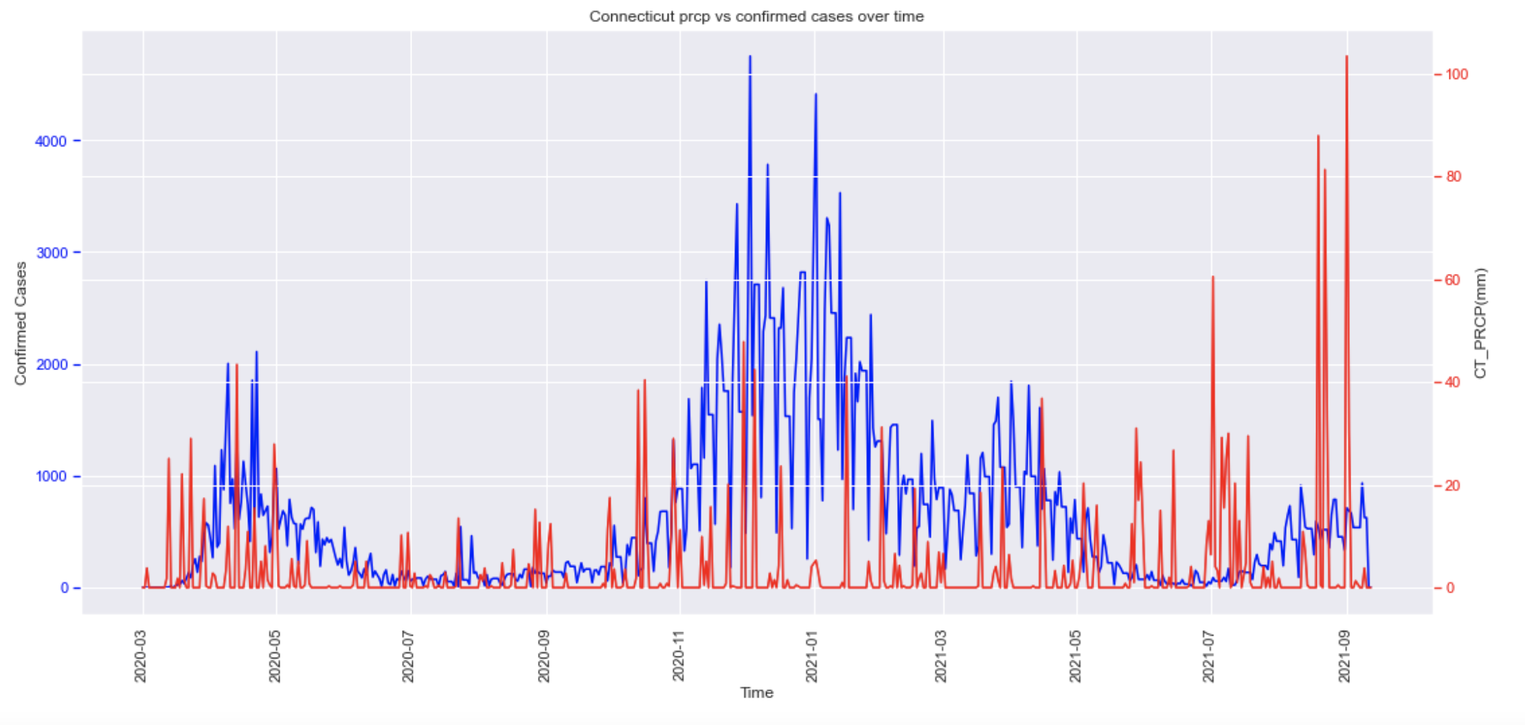
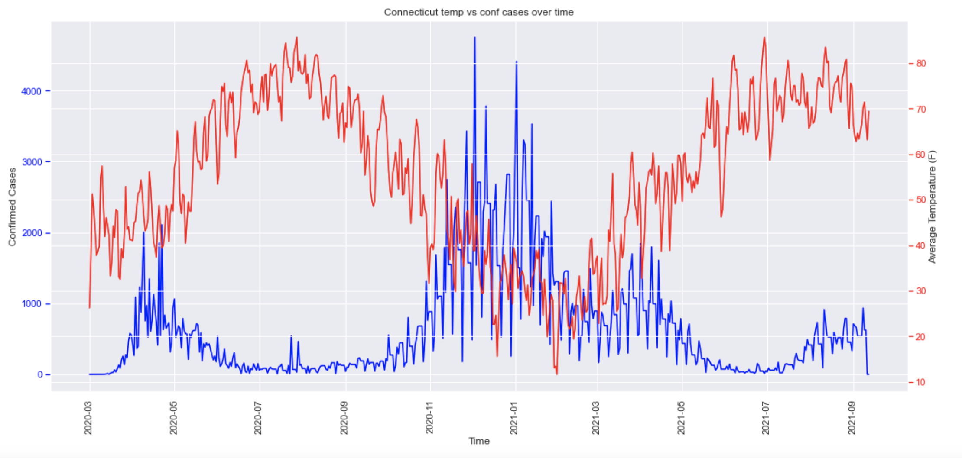
Connecticut

Slide 24
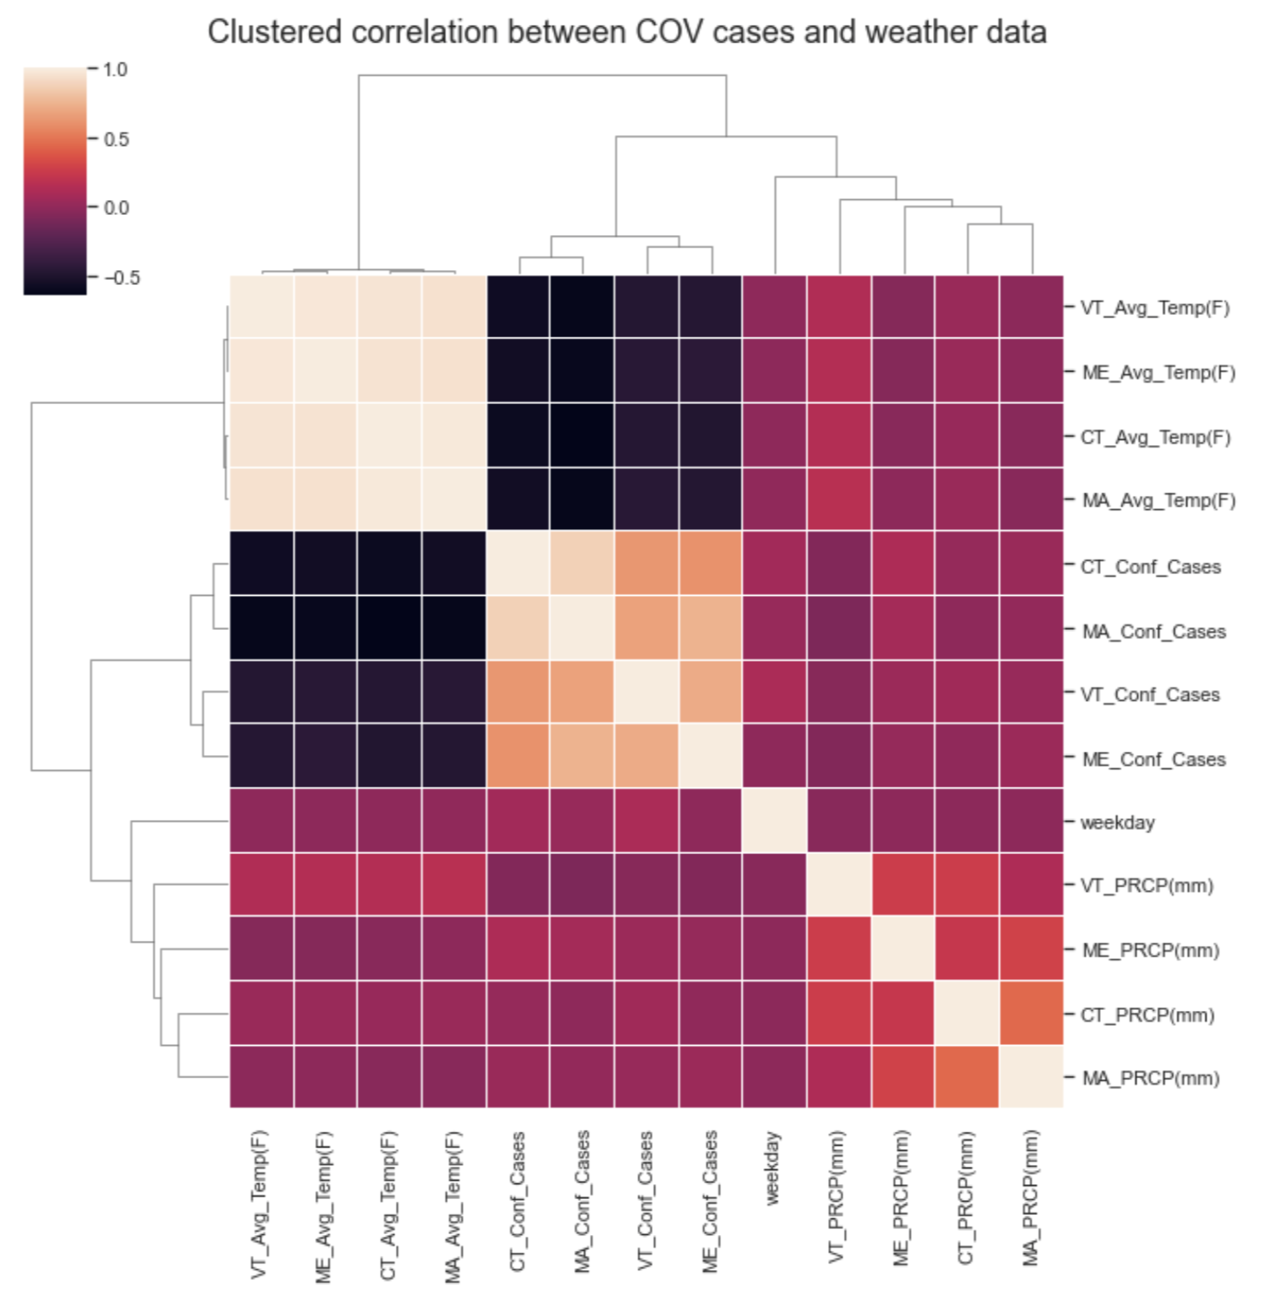
Feature correlation
Average temperatures and confirmed case counts: near-black squares
Massachusetts values are grouped most closely with Connecticut values = geographical grouping
Vermont values grouped most closely with Maine values = geographical grouping

Slide 25
Feature Engineering

Slide 26
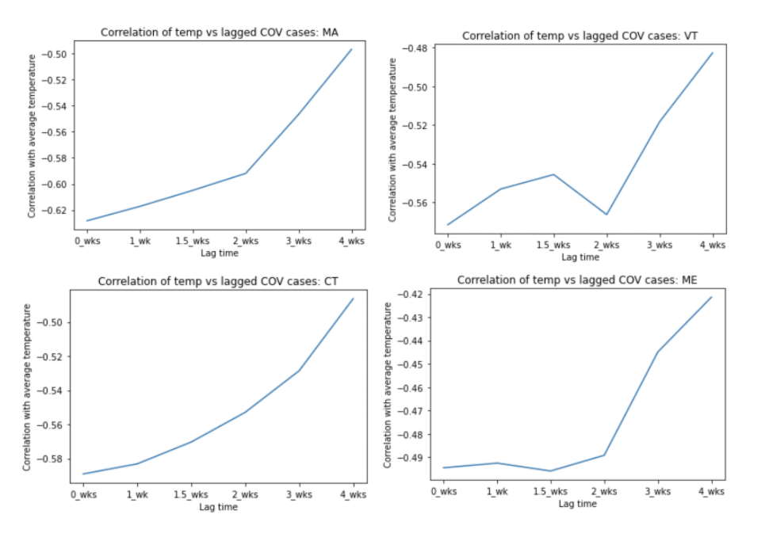
Lagged weather variables: TAVG
Possibly a correlation between some states and a lagged value of TAVG
At least 50% of the data do not indicate a correlation with lagged values
Lagged TAVG will not be considered in this project

Slide 27
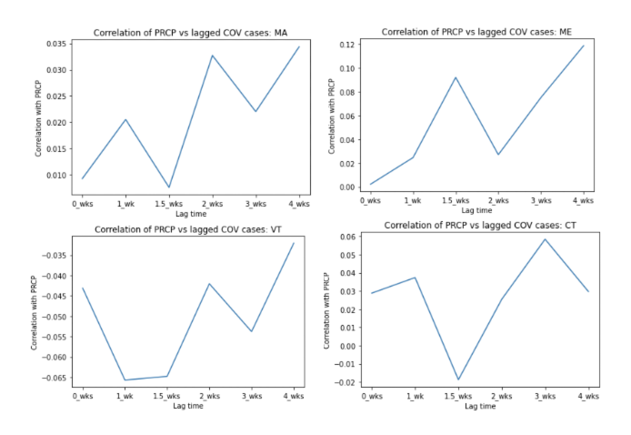
Lagged weather variables: PRCP
All states demonstrate a higher correlation between lagged PRCP values and COVID-19 cases
None agree on a optimal lagged value
Maximum correlation improvement with lagged PRCP: 0.1
There is no clear pattern in the trends, suggesting these results may very likely be random

Slide 28
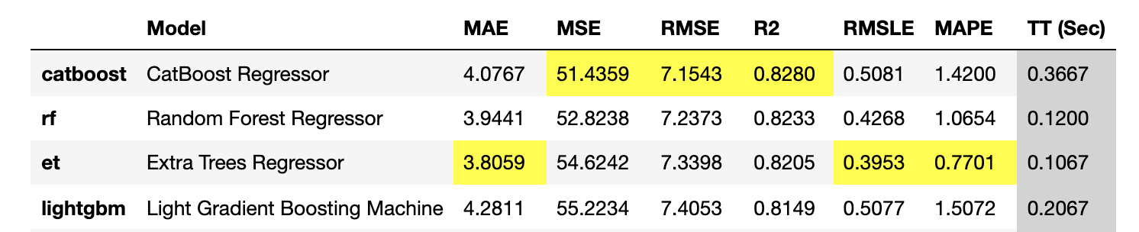
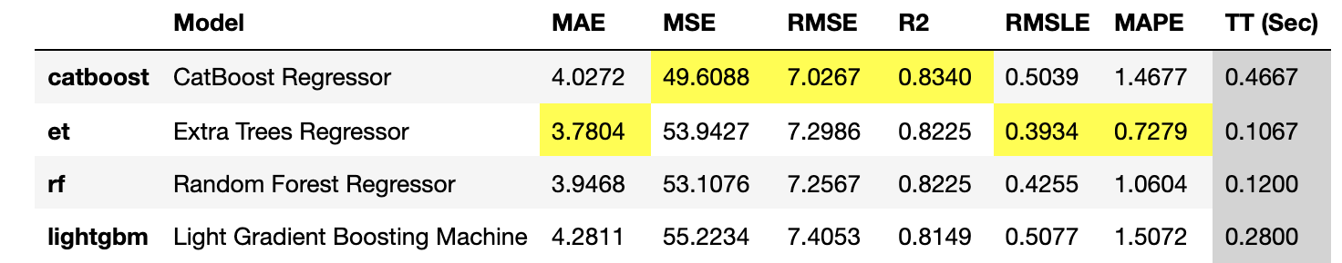
One-hot-encoding categorical variables
‘state_id’ must be one-hot-encoded
‘Month’ and ‘day_of_week’ could be represented categorically or numerically
With only ‘state_id’ one-hot-encoded
With all three columns one-hot-encoded

Slide 29
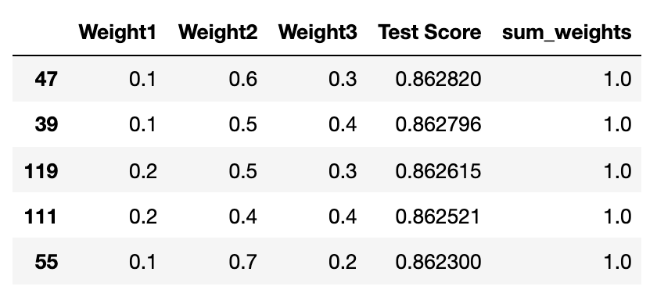

Weights and results
After tuning the hyperparameters of a Random Forest Regressor, Extra Trees Regressor, and CatBoost Regressor, feeding them into a Voting Regressor and determining the optimal weights of each estimator, the final model metrics were:

Slide 30
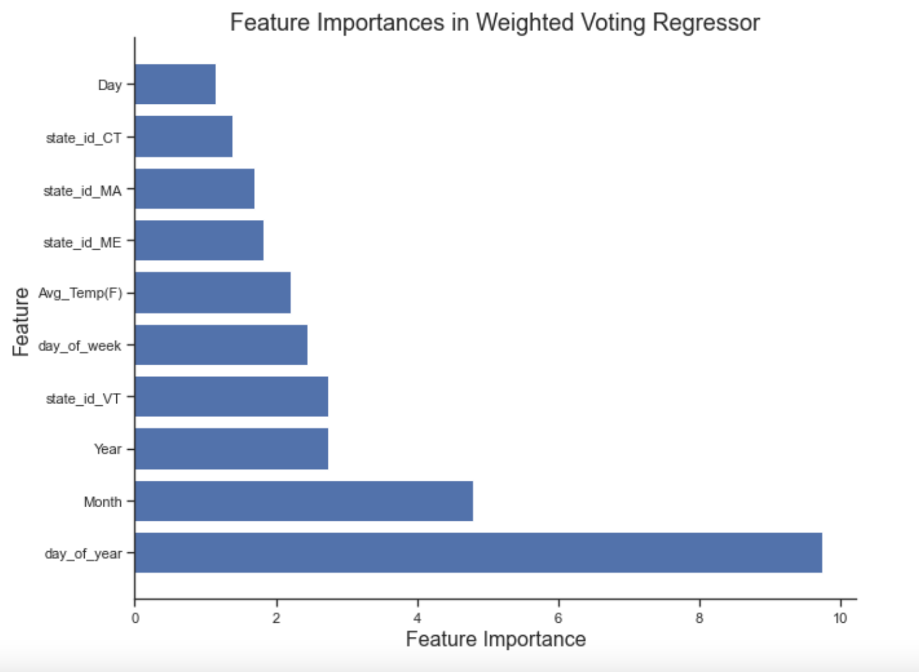
Feature Importance

Slide 31
Thank you!

